Slide 1
Performance Analysis of Machine Learning Techniques for Flight Ticket Price Forecasting
Done By:
Jaswanth Reddy Gillella 700744964
Berlin Bino Bright Christel Pappa 700741472
Ketan Sai Vemuri 700746604

Slide 2
Role/Responsibilities and Contribution
Berlin – Data Collection and Preprocessing
Responsible for gathering relevant data from various sources such as airline websites, APIs, publicly available datasets.
Responsible for cleaning and formatting the data for the data analysis.
Ketan – Exploratory Data Analysis(EDA)
Responsible for performing exploratory data analysis to gain insights into the dataset, visualize trends, patterns, and correlations.
Responsible for generating informative visualizations to better understand data.
Jaswanth – Model building and Model Evaluation
Responsible for conducting a comprehensive evaluation of various machine learning algorithms suitable for flight fare prediction.
Responsible for analyzing and comparing the performance of different models based on evaluation metrics.

Slide 3
Motivation
The aviation industry has witnessed a rapid growth in recent years, with an increasing number of people relying on air travel for both business and leisure purposes. As air travel becomes more accessible and affordable, there is a growing demand for accurate and reliable flight ticket price forecasting.
Predicting ticket prices accurately is essential for airlines, travel agencies, and passengers alike, as it enables better planning, informed decision-making, and cost optimization.
Traditional approaches to flight ticket price forecasting often rely on historical data and statistical models.

Slide 4
Objectives
Identify the key factors that significantly influence ticket prices and understand their impact on prediction accuracy.
Perform a comprehensive performance analysis of various machine learning techniques for flight ticket price forecasting.
Evaluate and compare different algorithms, identify a model with high accuracy and reliability.
Bridge the gap between machine learning and the aviation industry, contributing to the development of more accurate and reliable flight ticket price forecasting models.

Slide 5
Related Work
"Predicting Flight Ticket Prices Using Machine Learning Techniques" by Smith et al. (2018).
This study explores the application of various machine learning algorithms, including random forests, support vector regression, and artificial neural networks, for flight fare prediction.
The authors compare the performance of these techniques using historical flight data and provide insights into the factors that influence ticket prices.
2.
"A Comparative Study of Regression Techniques for Airfare Prediction" by Johnson et al. (2019).
The authors conduct a comparative analysis of multiple regression models, such as linear regression, polynomial regression, and gradient boosting regression, for airfare prediction.
They evaluate the models using a dataset comprising flight details, passenger information, and historical ticket prices, highlighting the strengths and limitations of each approach.

Slide 6
"Flight Fare Prediction using Deep Learning Models" by Patel et al. (2020).
This research paper investigates the use of deep learning architectures, specifically long short-term memory (LSTM) networks and convolutional neural networks (CNNs), for flight fare prediction.
The authors experiment with different network configurations and compare the performance of these models using historical flight data.
3.
4.
"Flight Fare Prediction: A Hybrid Approach" by Kumar et al. (2022).
The authors propose a hybrid approach combining regression models with feature selection and genetic algorithms for flight fare prediction.
They analyze the impact of various factors, such as route distance, departure time, and seasonality, on ticket prices and develop a hybrid model that offers improved accuracy compared to individual regression models.

Slide 7
Problem Statement
Develop an accurate and reliable machine learning model for predicting flight fares. The objective is to leverage historical flight data and relevant features to create a model that can effectively estimate the ticket prices for various flight itineraries. The model should be able to handle different airlines, departure times, routes, and other factors that influence fare variations.

Slide 8
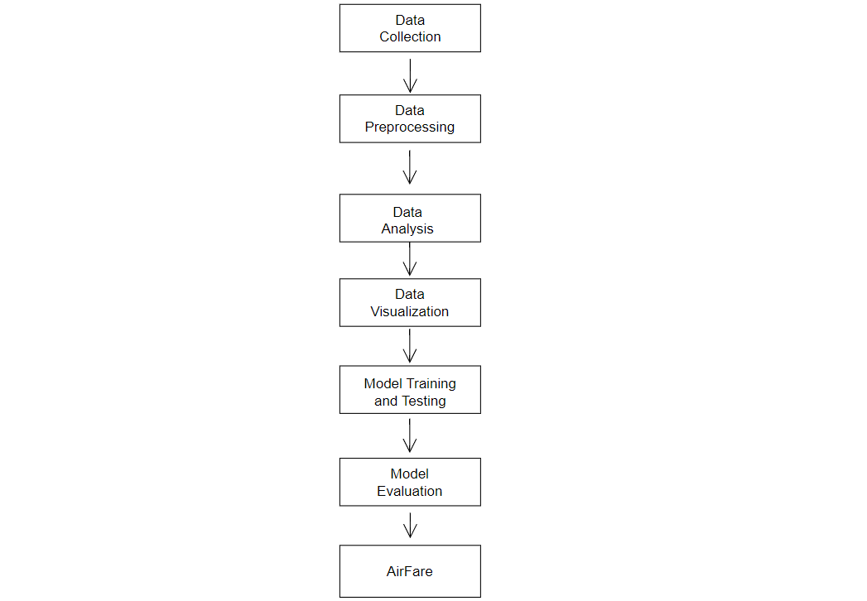
Proposed Solution
Fig. 1 Proposed framework for predicting the AirFare

Slide 9
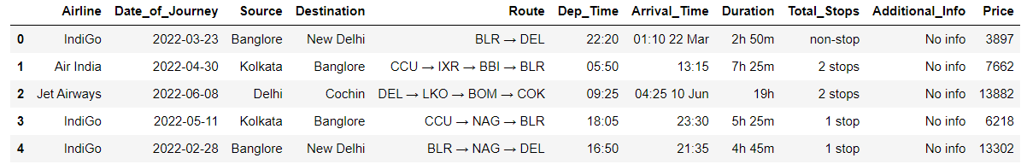
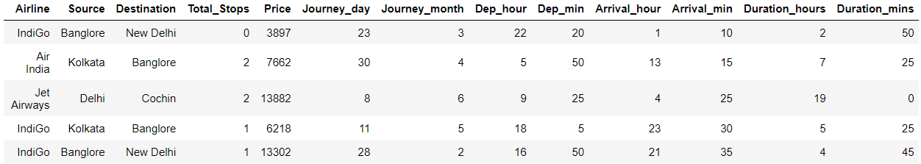
Step-1 Data Collection
The data set is collected from an online trusted resource named Kaggle.
The training data set contains the features, along with the prices of the flights. It contains 10683 records, 10 input features and 1 output column — ‘Price’.
Following is the features available in the dataset – Airline, Date_of_Journey, Source, Destination, Route, Dep_Time, Arrival_Time ,Duration, Total_Stops, Additional_Info, Price.
Fig. 2 Raw Data Set
Step-2 Data Preprocessing
Fig. 3 Data Set after cleaning and preprocessing

Slide 10
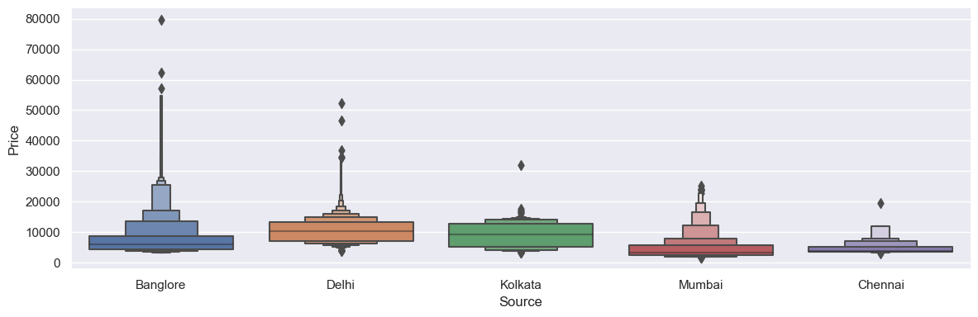
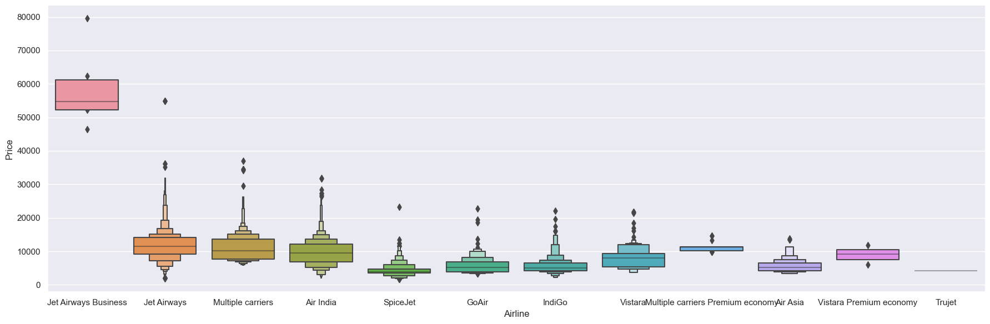
Step-3 Data Analysis and Visualization
Fig. 4 catplot for Source Vs Price
Fig. 5 catplot for Airline Vs Price

Slide 11
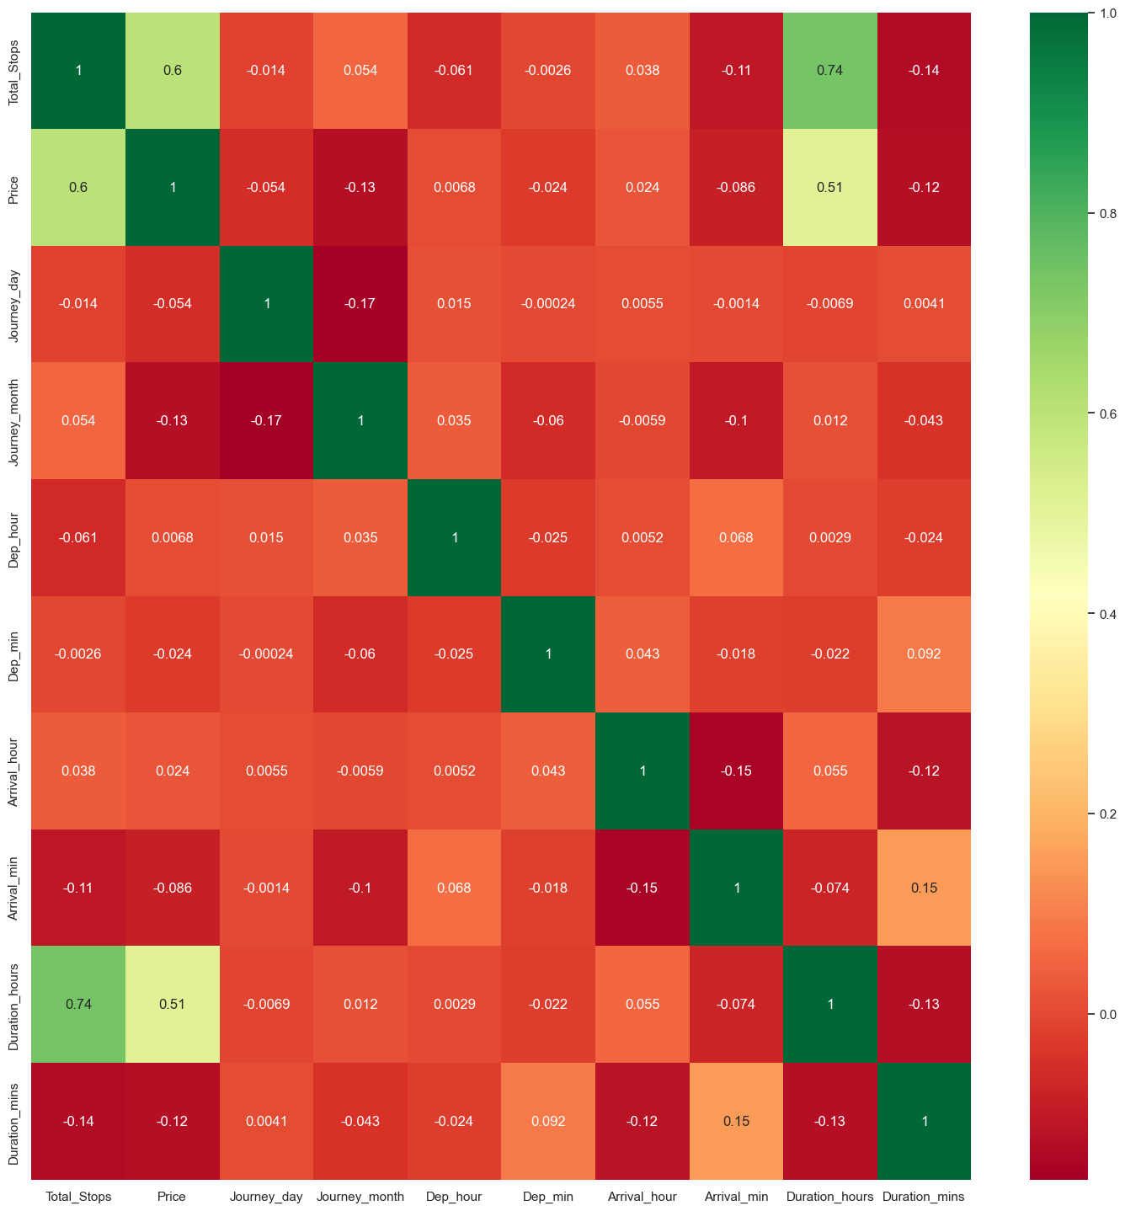
Fig. 6 HeatMap of Features

Slide 12
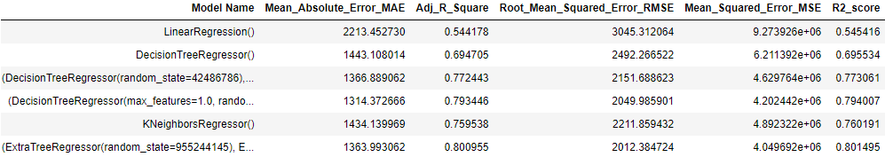
Model Training and Evaluation
The pre-processed data is divided into training and testing data sets in 70:30 ratio. Six different machine learning algorithms including LinearRegression, DecisionTreeRegression, KNeighborsRegression, RandomForestRegression, ExtraTressRegression and BaggingRegression were applied on train data.
Once the training is completed, we have evaluated the performance of algorithms using different evaluation metrics like Adjusted R square, Root mean squared Error etc.
Fig. 7 Evaluation Metrics of different algorithms used to predict AirFare

Slide 13
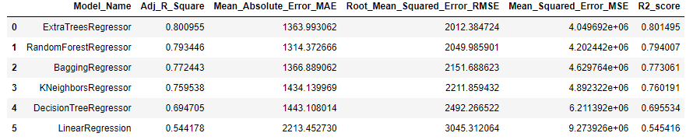
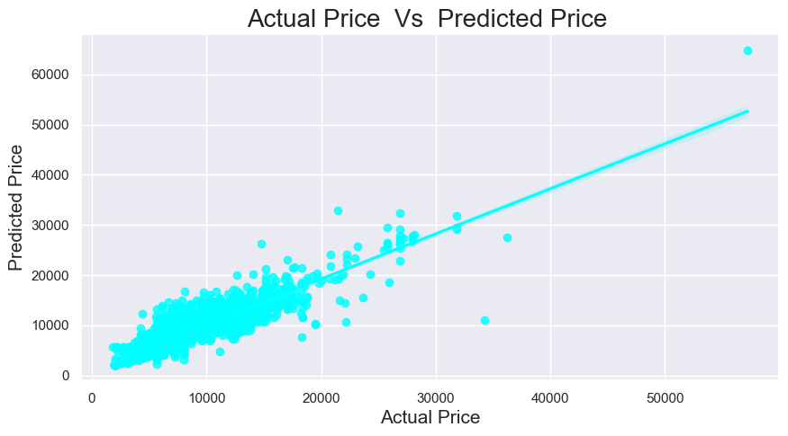
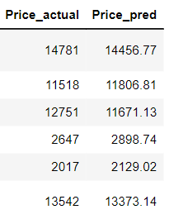
Results
Fig. 8 Sorted list of algorithms based on Adj_R_Square
Fig. 9 Actual price and Predicted Price
Fig. 10 Regplot for Actual price Vs Predicted Price

Slide 14
References
Viet Hoang Vu, Quang Tran Minh and Phu H. Phung “An Airfare Prediction Model for Developing Markets” , IEEE paper 2018.
Supriya Rajankar, Neha sakhrakar and Omprakash rajankar “Flight fare prediction using machine learning algorithms” International journal of Engineering Research and Technology (IJERT) June 2019.
R. Raja Subramanian, Marisetty Sai Murali, B Deepak “Airline Fare Prediction Using Machine Learning Algorithms”, IEEE paper 2022.
A. Boruah, K. Baruah, B. Das, M. Das and N. Gohain, "A Bayesian Approach for Flight Fare Prediction Based on Kalman Filter", Progress in Advanced Computing and Intelligent Engineering Singapore, pp. 191-203, 2019.

